Slide 1
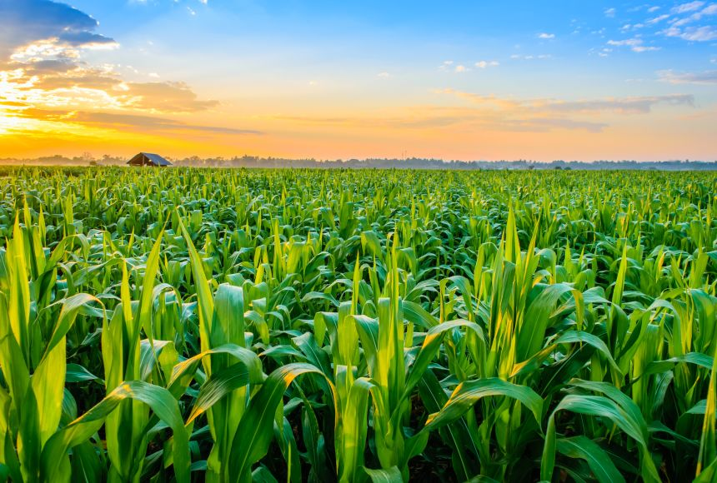
Introduction to Crop Production Analysis in India
Harvesting Insights: Unveiling Crop Production Analysis in India Amidst Technological Evolution

Slide 2
Project Title - | Crop Production Analysis in India
Technologies - | Data Science
Domain - | Agriculture

Slide 3







Technologies Used –

Slide 4





KPI’s (Key Performance Indicators)
State – the geographic location or administrative division in India
Crop - the specific type or variety of crop being cultivated and harvested
Production - the total quantity of a specific crop harvested within a given state and year, typically measured in units such as tons or kilograms
Season-the specific season or time period during which the crop was cultivated and harvested
Year - indicates the specific calendar year in which crop production data was collected or reported.

Slide 5
Factors Affecting Crop Production
Climate
Climate plays a crucial role in determining crop suitability, growth, and yield.
Soil quality
Soil fertility, texture, structure, and nutrient content significantly influence crop growth and productivity.
Water availability
Adequate water supply is critical for crop growth, and water availability varies depending on factors such as precipitation, irrigation practices, and water management systems.
Agricultural difference
Farming practices, including crop selection, planting techniques, fertilization, pest management, and crop rotation, significantly impact crop production.

Slide 6
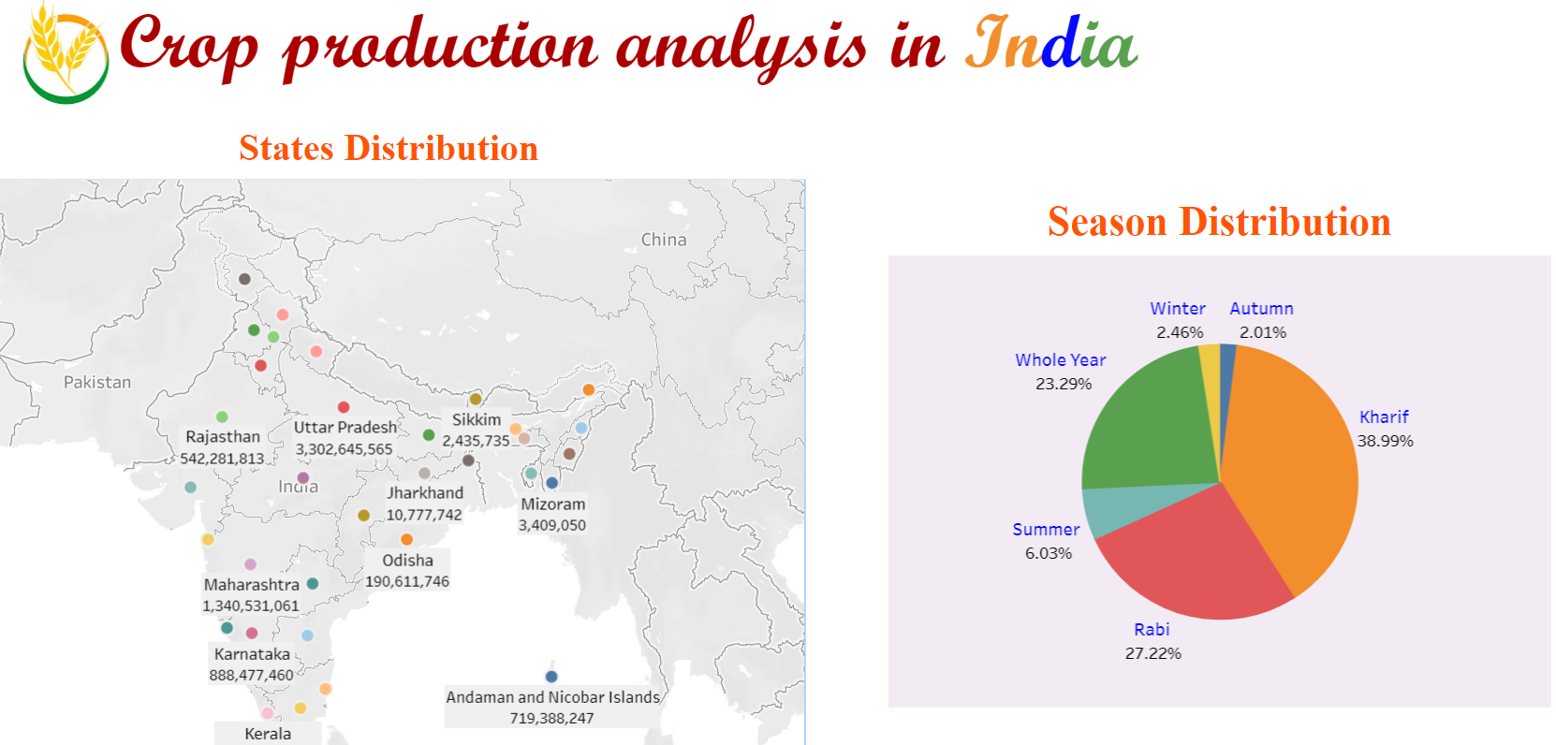

Slide 7
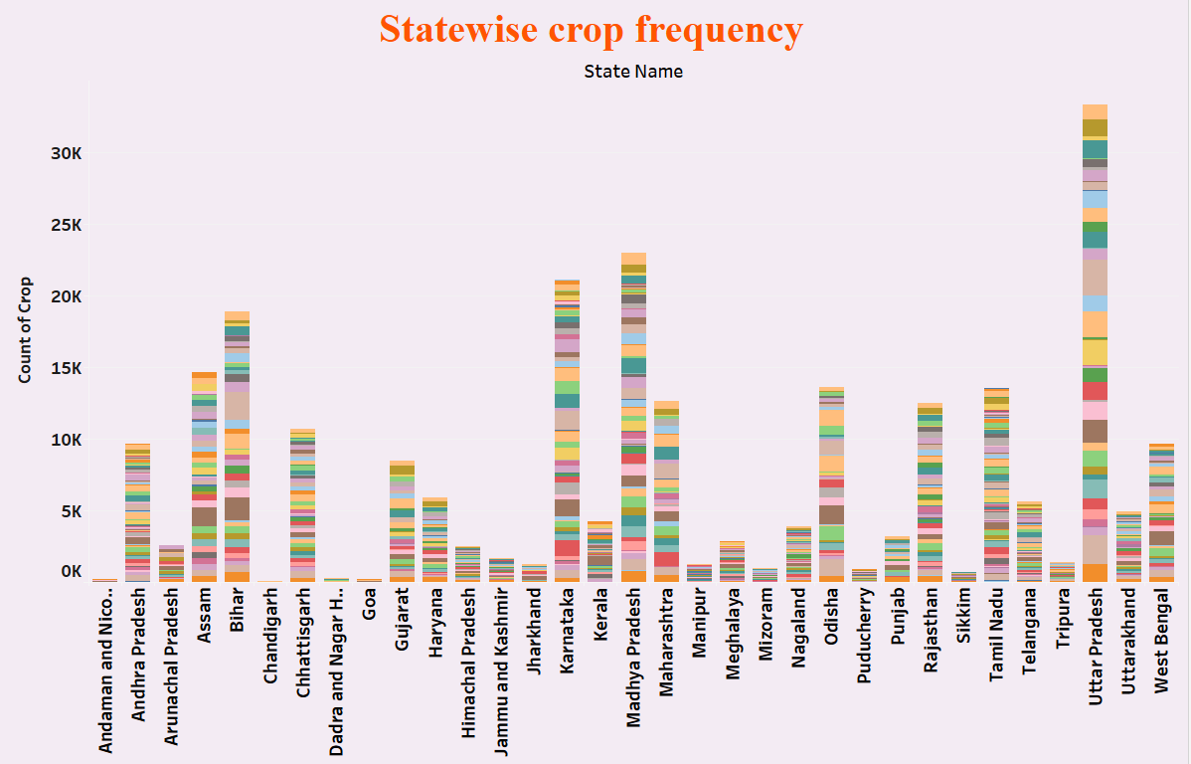

Slide 8
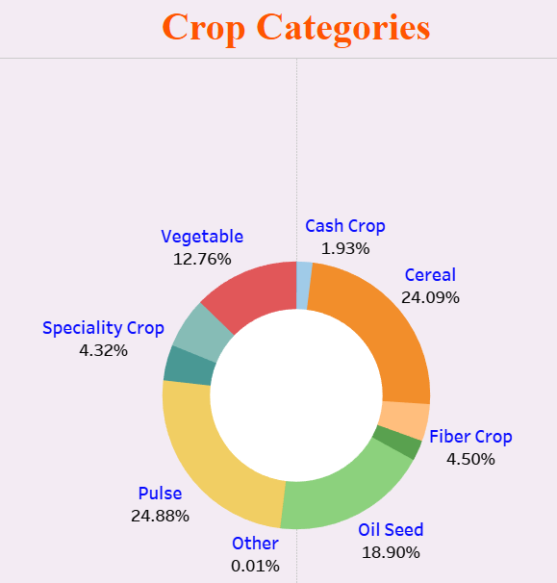

Slide 9
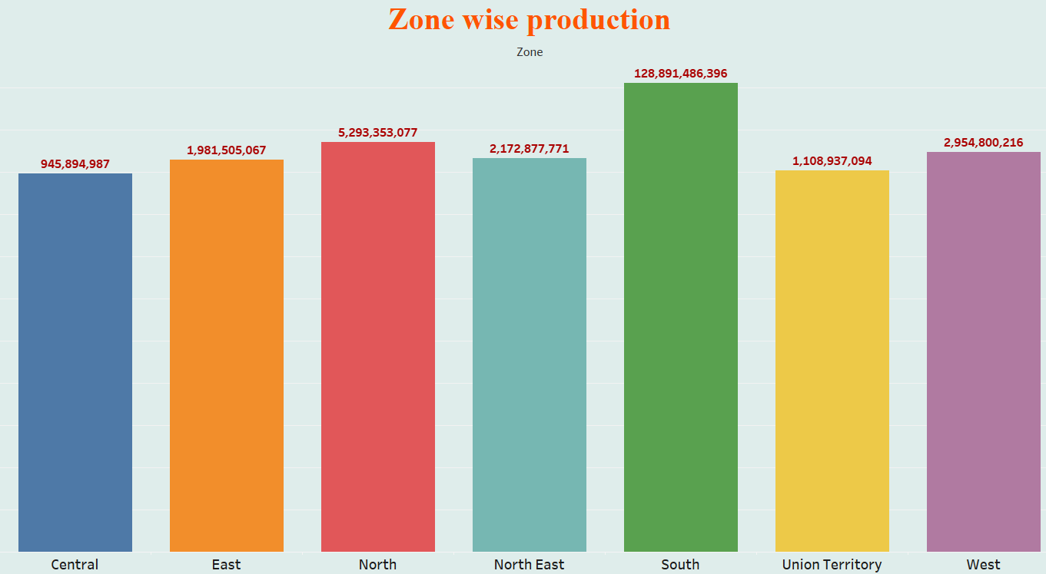

Slide 10
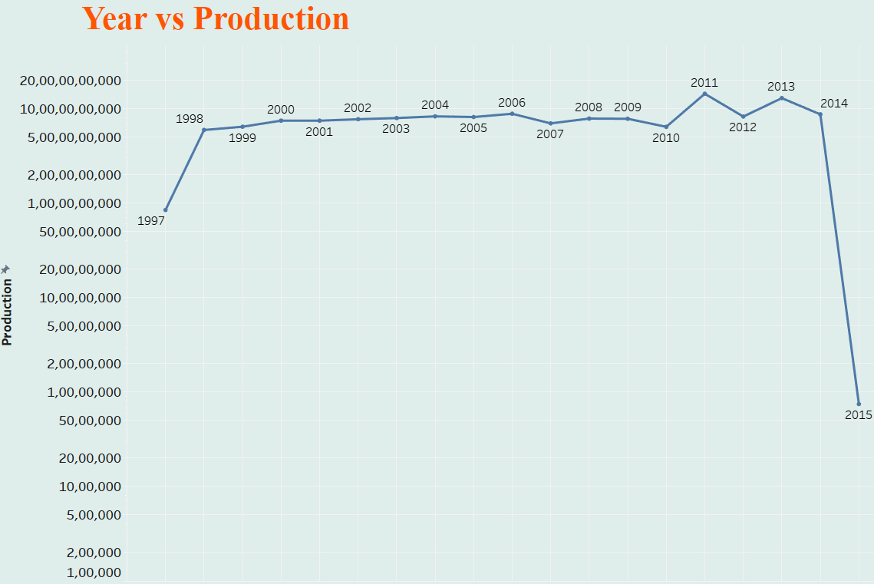

Slide 11
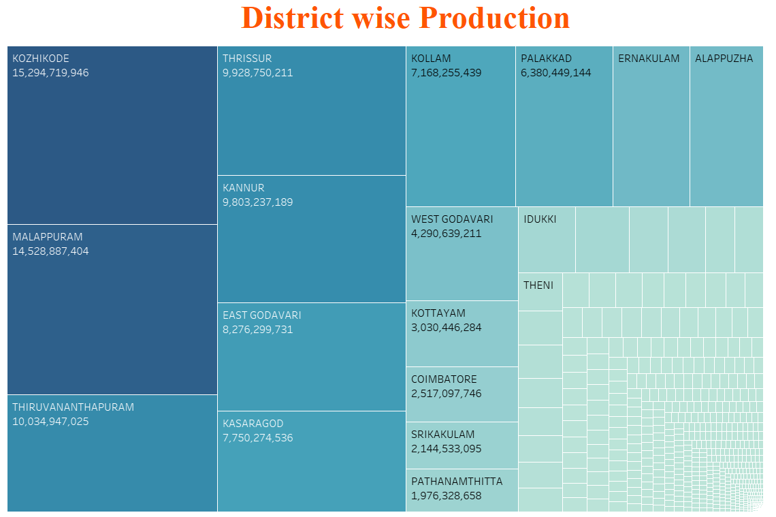

Slide 12
Future Trends
1
Digital Agriculture
leverages digital technologies leading to increased productivity
2
Circular Agriculture
aims to close nutrient loops, minimize waste, and maximize resource efficiency
Biotechnology and Genomics
helps developing crops with improved traits
3

Slide 13
Thank you!

